Slide 1

My Favarite Football
Club
FC Barcelona (Barca)

Slide 2
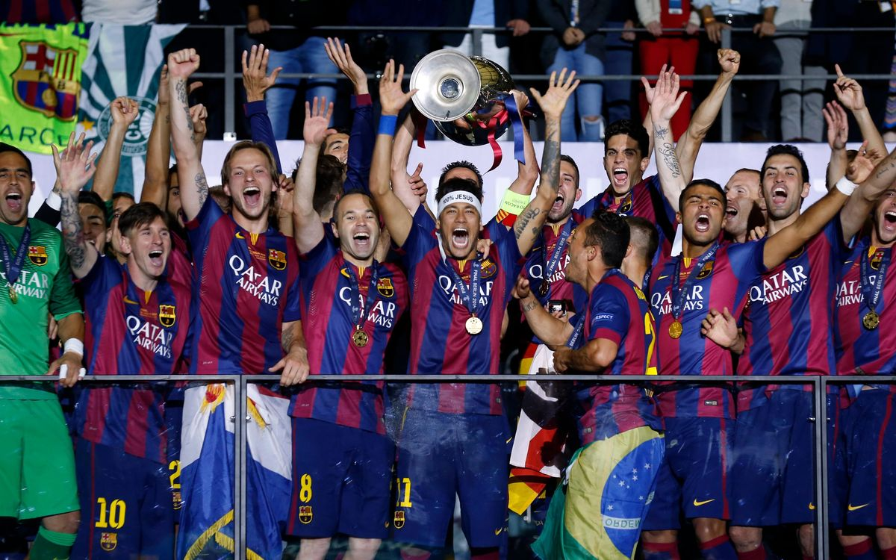
Slogan: More Than a Football Club
Since 1899, Barcelona has been a symbol of beautiful football, passion, and unwavering values. The club embodies the famous motto "Més que un club" – More than a club.

Slide 3
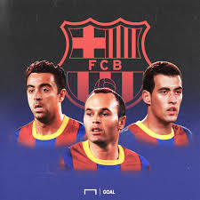
Tiki-Taka: The Art of Possession
01
02
Short Passes
Smart Movement
Quick, accurate passes to maintain control
Constant positioning and off-the-ball runs
03
Total Control
Opponents chase endlessly while Barca dominates
Barcelona doesn't just play to win – they create art on the pitch with their signature style.

Slide 4
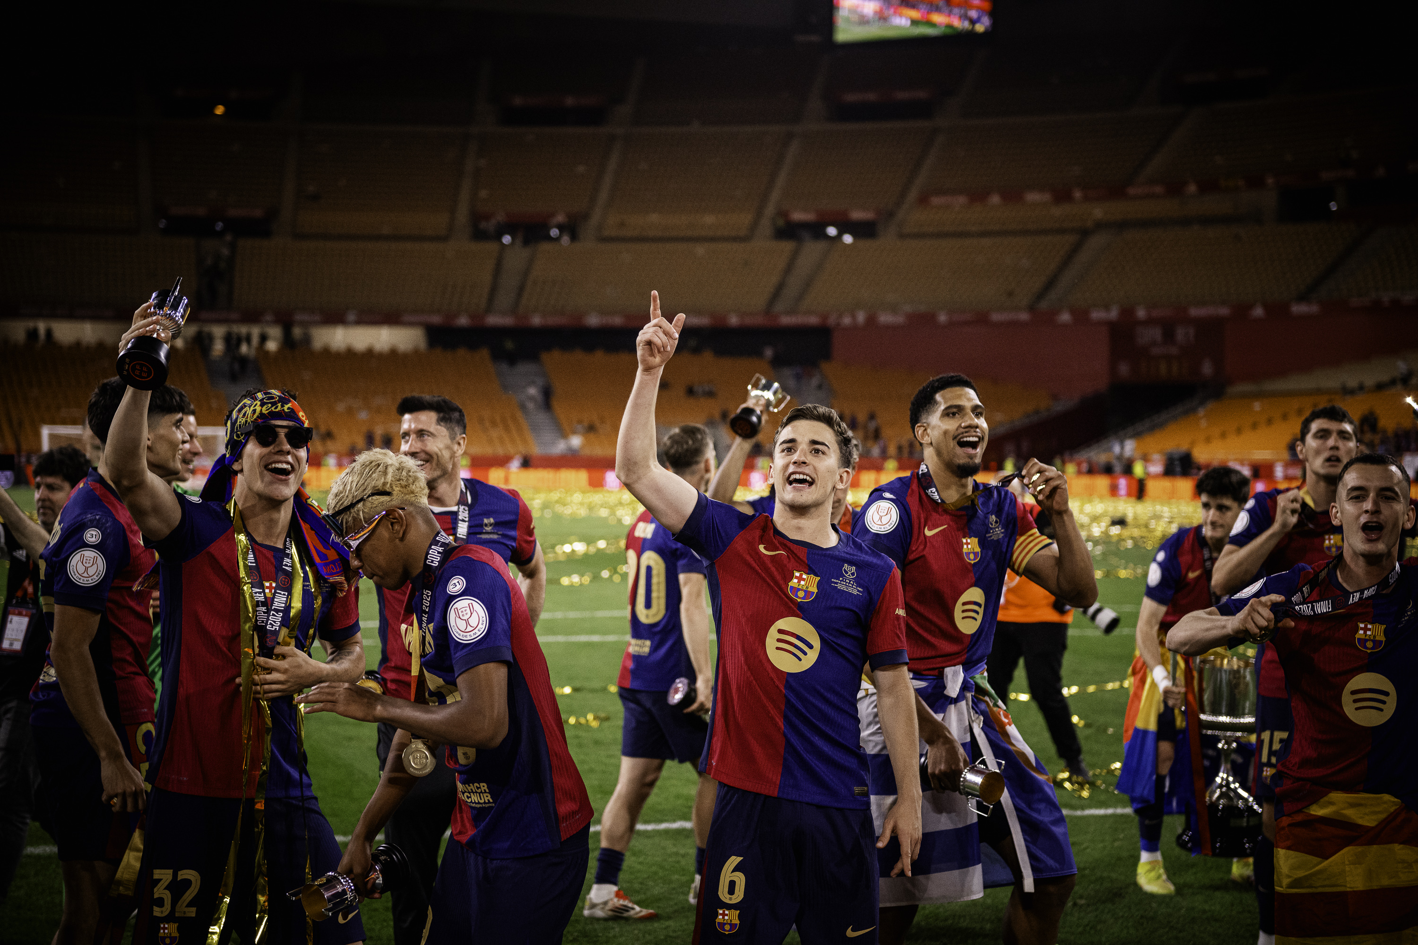
A Legacy of Success
World-Class Achievements
One of the most successful clubs in football history, Barcelona has won over 25 La Liga titles and 5 UEFA Champions League trophies. Their consistent excellence spans decades.

Slide 5



La Masia – The Academy of Champions
World-Class Training
Attacking Philosophy
Club Values
La Masia develops the finest young talents through exceptional coaching and dedication
Young players learn Barcelona's identity, discipline, and the famous tiki-taka style
Players are taught to control games with possession and creativity from day one
La Masia isn't just an academy – it's the heart of Barcelona's football philosophy, producing legendary players who embody the club's spirit.

Slide 6
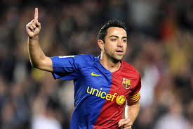
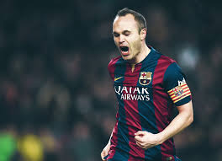
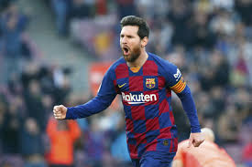
The Legend In club
Xavi
Iniesta
Messi
The midfield brain who orchestrated every game with vision and precision
The silent hero with magical feet who scored in the World Cup final
The football magician who brought joy and incredible skill to Camp Nou

Slide 7
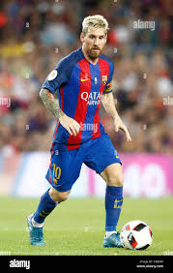
Lionel Messi – The Greatest Icon
8
672
35
Ballon d'Or Awards
Goals for Barca
Trophies Won
Messi is not only Barcelona’s greatest player, but also a football legend who redefined what is possible on the pitch. His loyalty, talent, and humility made him the true heart of the club.

Slide 8
Why I Love Barcelona ❤️
Beautiful Football
Trust in Youth
They play with artistry and passion, making every match a spectacle
Young players are given opportunities to shine and grow
Never Give Up
Values & Creativity
They fight until the final whistle, even in the toughest times
They represent passion, integrity, and the courage to be different
Barcelona taught me that winning beautifully is the greatest victory.

Slide 9

Barcelona in My Heart
Not just a football club, but my childhood, my inspiration, my lifelong passion.
Win or lose – I will always be a Cules (Barca fan)

